Slide 1
Lab 26. 0 to 9 Counter with Display

Slide 2
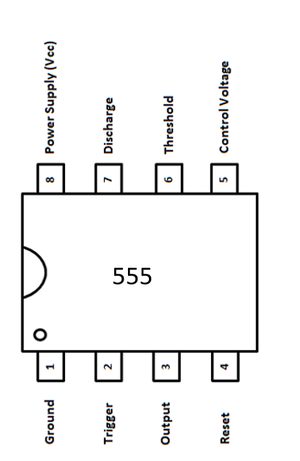
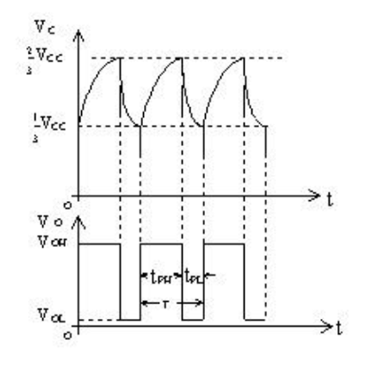
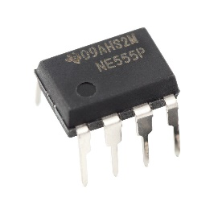
IC circuits
555 Timer IC

Slide 3
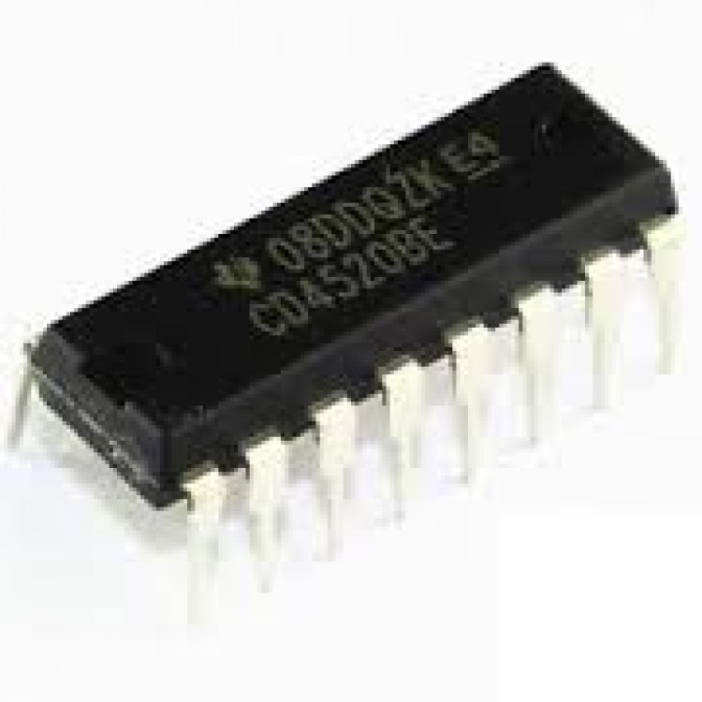
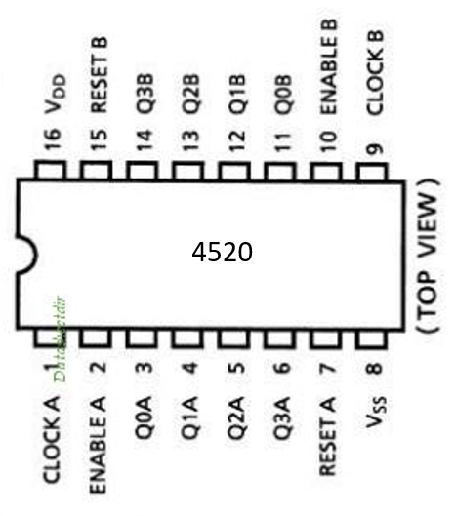
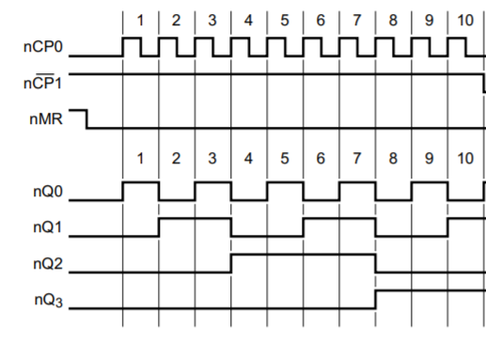
IC circuits
4520 IC

Slide 4
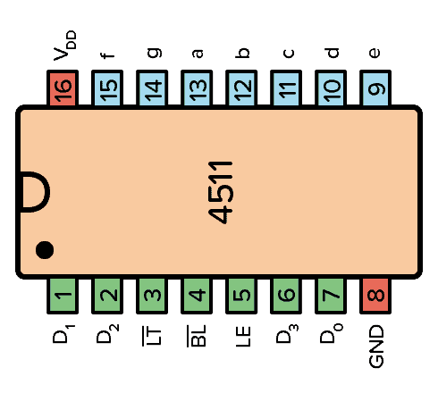
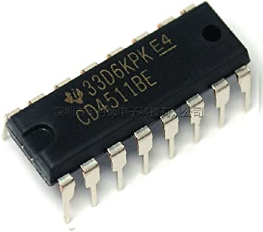
IC circuits
4511 IC

Slide 5
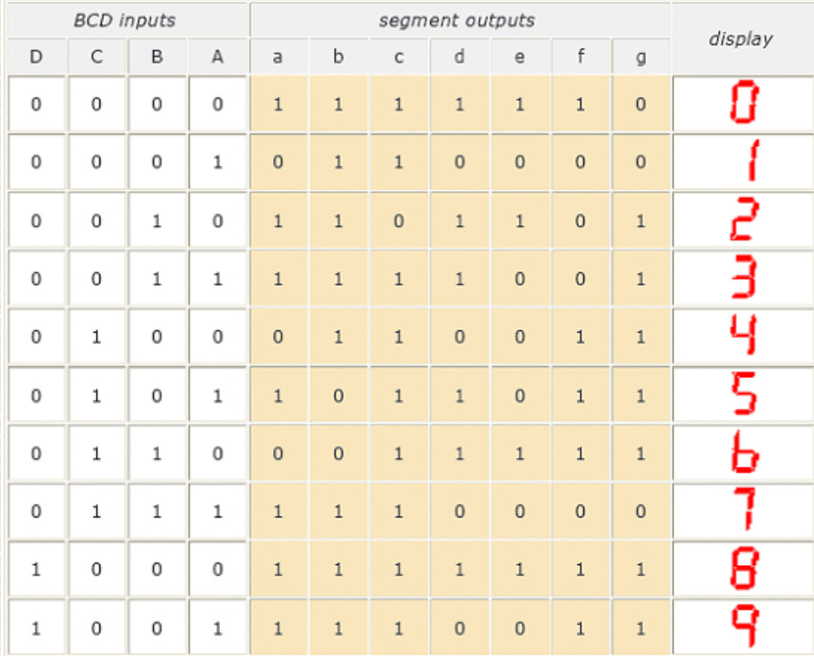
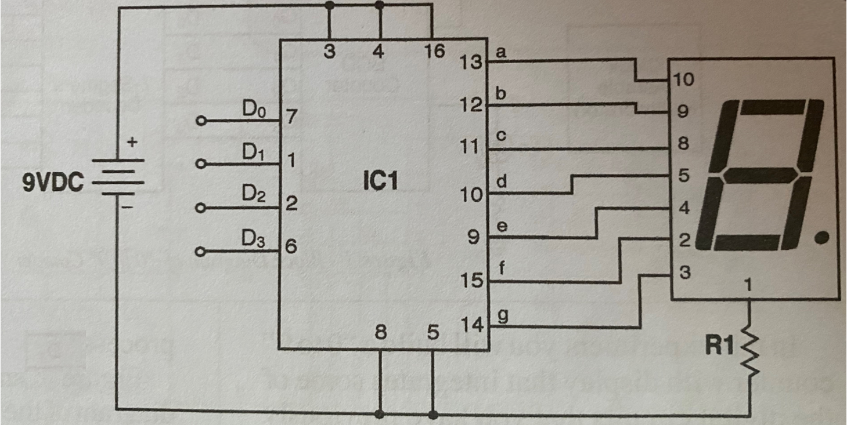
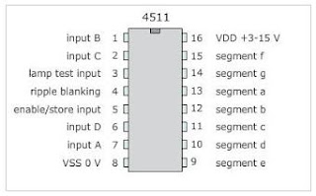
IC circuits
4511 IC

Slide 6
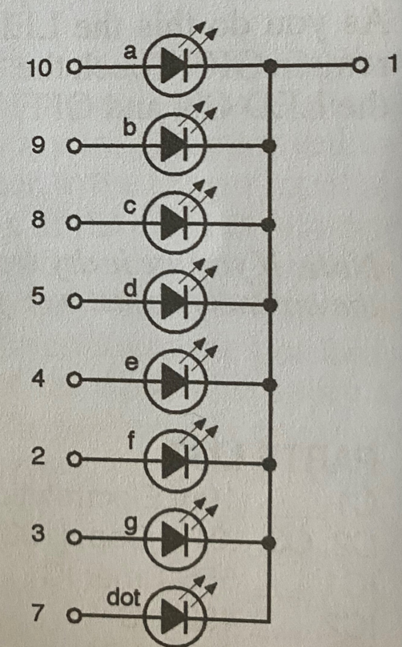
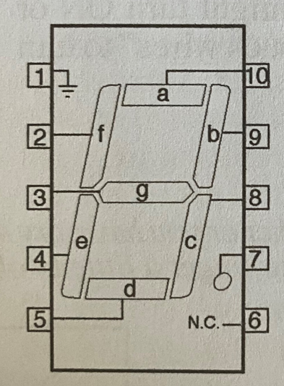
7 segment display

Slide 7
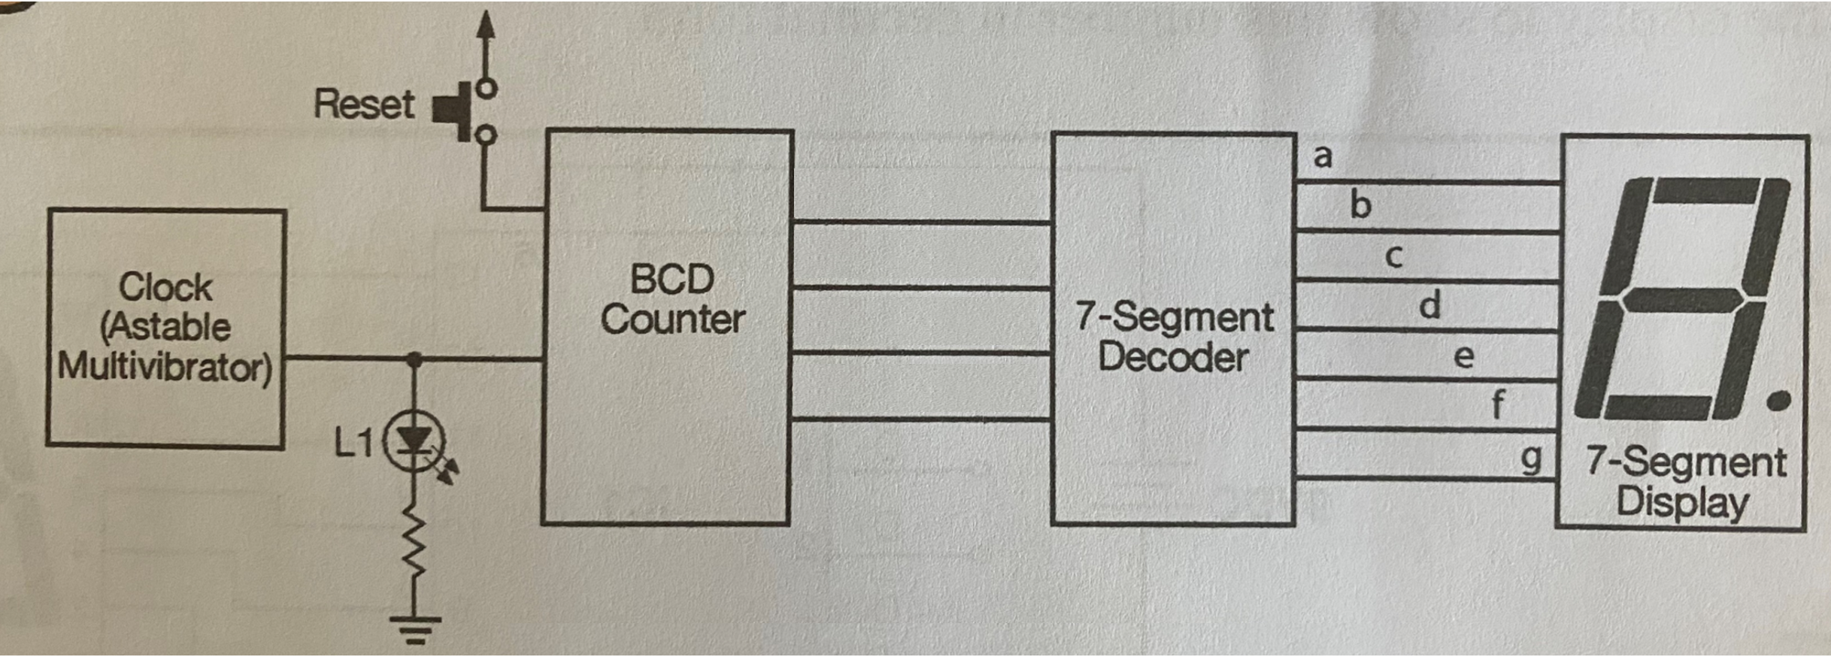
Circuit design

Slide 8
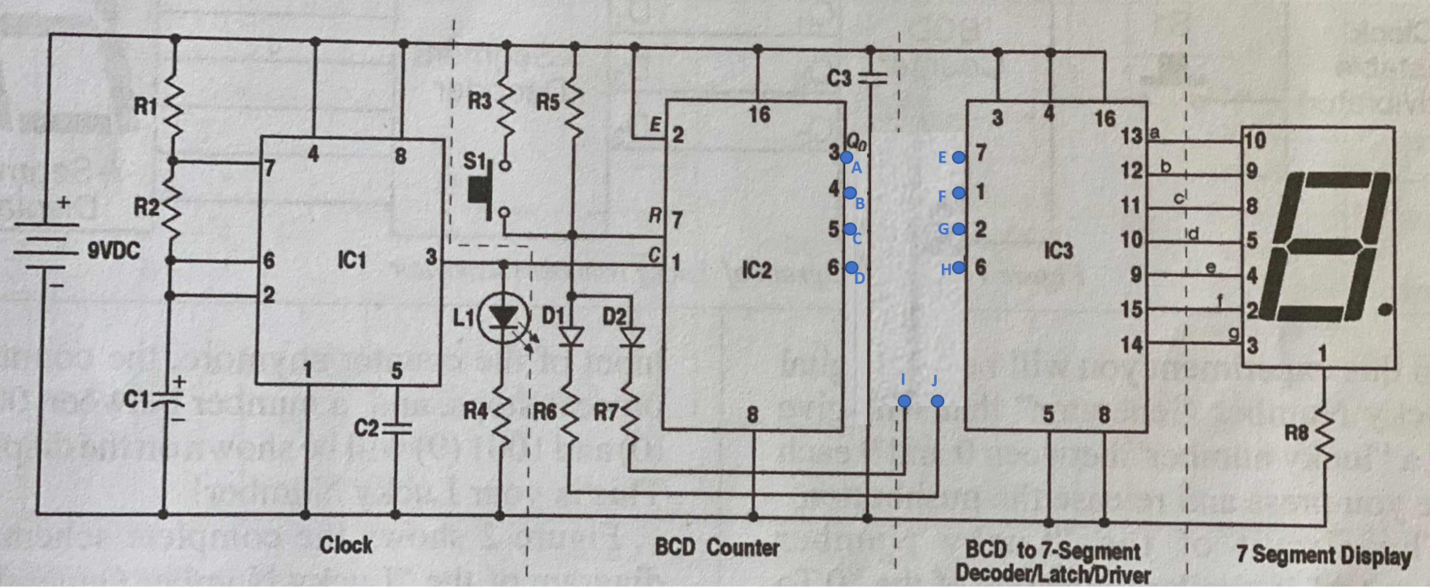
Requirements:
sketch the connections between A, B, C, D and E, F, G, H, I, J.
Build the circuit.

Slide 9
Components
C1 10μF electrolytic capacitor
C2, C3 0.01μF Disc capacitor
D1, D2 1N4148 Diode
IC1 555 timer IC
IC2 4520 IC
IC3 4511 IC
L1 red LED
R1 10KΩ resistor(brown,black,orange)
R2 68KΩ resistor(blue,grey,orange)
R4 1KΩ resistor(brown,black,red)
R3, R6, R7, R8 220Ω resistor(red,red,brown)
R5 4.7KΩ resistor(yellow,violet,red)
S1 pushbutton switch

Slide 10
Some tips
Make sure the direction of IC is correct
When making connections, check each pin of the IC, if it’s properly connected, don’t miss any pin.
Put 555 as left as possible on the breadboard to get more space to make the connections
Don’t press 7 segment display too deep, otherwise, you cannot find the place of the pin.
Each IC circuit is placed in the center of the breadboard, so each pin occupies one single column

Slide 11
Requirements
You are allowed to work as a group, at most two people
Demonstrate that 0 to 9 can be displayed in turn. If not checked in class, submit the result to canvas.

